Slide 1

Department of Electronics and Communication Engineering
Soft Error Resilient 16T SRAM Arrays in 45nm & 65nm CMOS For Aerospace Applications
Name of the Guide
Mr. Ramesh Babu
Asst. Prof
Students Name and Roll Numbers
1.V.Sravanthi-218T1A0499
2.K.Vinod Kumar-218T1A0474
3.Md.Imran-218T1A0484
4. Ch.Chaitanya Kumar-218T1A0459

Slide 2
Contents
Abstract
Introduction
Literature survey
Problem statement
Objective
Proposed technique
Results
Future scope
Conclusion
References

Slide 3
Abstract
In this paper, we present the design and comparative analysis of soft-error-aware 16T SRAM arrays using 45 nm and 65 nm CMOS technologies, with a focus on aerospace applications.
Aerospace environments are highly susceptible to radiation-induced soft errors, which demands the development of robust memory systems.
First, we designed a single-bit 16T SRAM cell optimized for multi-node upset tolerance, incorporating advanced error correction and radiation-hardening techniques to enhance reliability.
The single-bit cell design is then scaled to an 8x 8 SRAM array architecture. Both the 45 nm and 65 nm versions of the array we redeveloped and simulated to evaluate key performance metrics, including area, delay, and power consumption.
The results indicate that while 45nm technology achieves better performance and area efficiency, 65nm technology excels in power savings and reliability. This comprehensive study underscores the importance of technology selection in optimizing SRAM design for high-reliability aerospace applications, offering a framework for future advancements in radiation-hardened memory systems.

Slide 4
Introduction
In the ever-evolving landscape of modern electronics, low-power consumption has become one of the most critical challenges in the design of integrated circuits (ICs).
The rapid proliferation of portable devices, such as smartphones, wearables, and IoT (Internet of Things) gadgets, necessitates the development of energy-efficient components to maximize battery life without compromising performance.
Static Random-Access Memory (SRAM) plays a crucial role in many electronic systems, serving as the primary memory for storing data in both embedded systems and high-performance processors.
SRAM, due to its high speed and simplicity of design compared to Dynamic RAM (DRAM), remains a preferred choice for on-chip memory. However, its inherent power consumption has become a significant concern as devices become increasingly compact and portable.

Slide 5
Literature Survey
SI.NO | Title Of The Paper | Author’s Name | Year of Publication
1. | Variation tolerant differential 8T SRAM cell for ultralow power applications | S. Pal and A. Islam | Apr.2013
2. | A soft error tolerant 10T SRAM bit-cell with differential read capability | S. M. Jahinuzzaman, D. J. Rennie, and M. Sachdev | Dec.2009
3. | Soft-error resilient read decoupled SRAM with multi-node upset recovery for space applications | S. Pal, D. D. Sri, W.-H. Ki, and A. Islam | May.2021
4. | Energy-efficient dual-node-upset-recoverable 12T SRAM for low-power aerospace applications | S. Pal, G. Chowdary, W.-H. Ki, and C.-Y. Tsui | 2023
5. | Design and performance evaluation of radiation hardened latches for nanoscale CMOS | ] S. Lin, Y.-B. Kim, and F. Lombardi | Jul.2011

Slide 6
Problem statement
Traditional SRAM architectures like 6T and 8T are highly vulnerable to soft errors due to radiation exposure in aerospace environments, leading to potential data corruption and system instability.
There is a critical need for fault-tolerant and radiation-resilient SRAM designs to ensure reliability in aerospace systems where high-energy particles frequently affect electronic circuits.
Choosing between 45nm and 65nm CMOS technologies involves trade-offs in performance, power efficiency, area utilization, and error tolerance, which complicates the selection of the optimal technology for aerospace applications.
As technology scales down, smaller nodes such as 45nm become more sensitive to ionizing radiation, increasing the occurrence of single-event and multi-node upsets, necessitating robust memory architectures like the proposed 16T SRAM.

Slide 7
Objective
To design a soft-error-resilient 16T SRAM cell optimized for aerospace applications exposed to high radiation levels.
To implement and compare the 16T SRAM architecture using both 45nm and 65nm CMOS technologies.
To analyze and evaluate the performance of the proposed SRAM designs in terms of area, power consumption, and delay.
To enhance the SRAM cell's tolerance to multi-node upsets (MNUs) and single-event upsets (SEUs) through transistor-level modifications and integration of error correction and radiation-hardening techniques.
To simulate and evaluate an 8×8 SRAM array derived from the single-bit cell using Tanner EDA tools, analyzing its behavior under various operating and fault conditions.
To provide a comprehensive comparison that helps guide the selection of suitable CMOS technology for high-reliability aerospace memory systems.

Slide 8
Proposed Methodology
The paper proposes low-power SRAM designs like AS10T, DS10T, and CNTFET-based SRAM to reduce power consumption and leakage currents, with CNTFETs offering a promising alternative to CMOS for better speed and efficiency.
Dual-supply voltage optimization (VDDH and VDDL) in DS10T SRAM significantly reduces write cycle power by 75%, while optimized transistor arrangements minimize power dissipation and improve stability.
The proposed architectures enhance read and write operations by reducing bitline switching power, improving noise margins, and ensuring efficient data access for IoT and battery-operated systems.
Future improvements include scaling optimizations, hybrid transistor technologies, and AI-driven power management, aiming to enhance next-generation ultra-low-power SRAM efficiency.

Slide 9
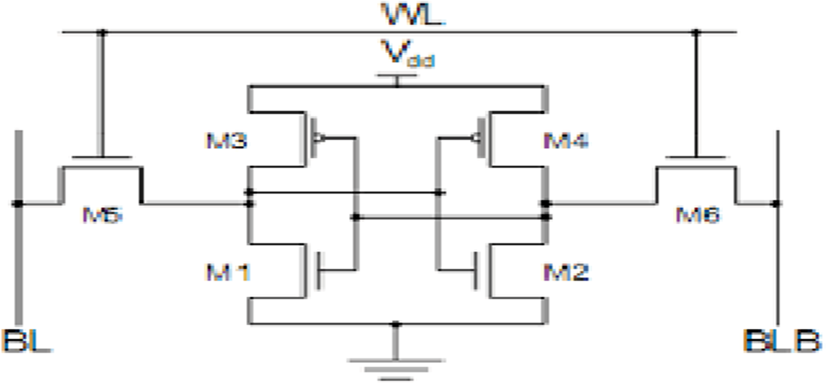
Block Diagram

Slide 10
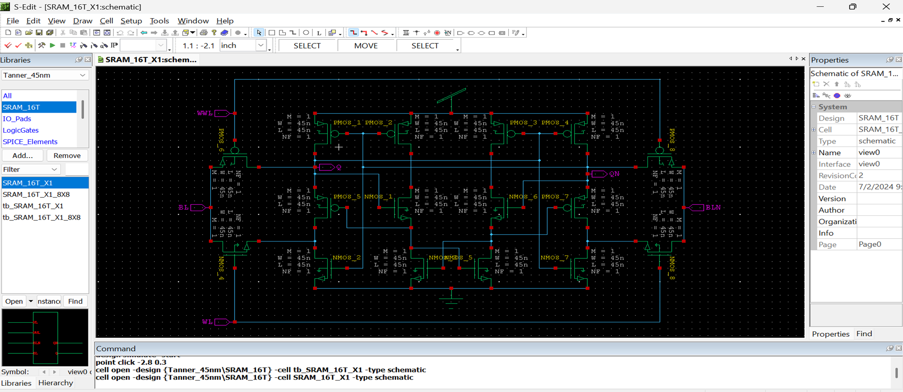
Simulation Using 45nm

Slide 11
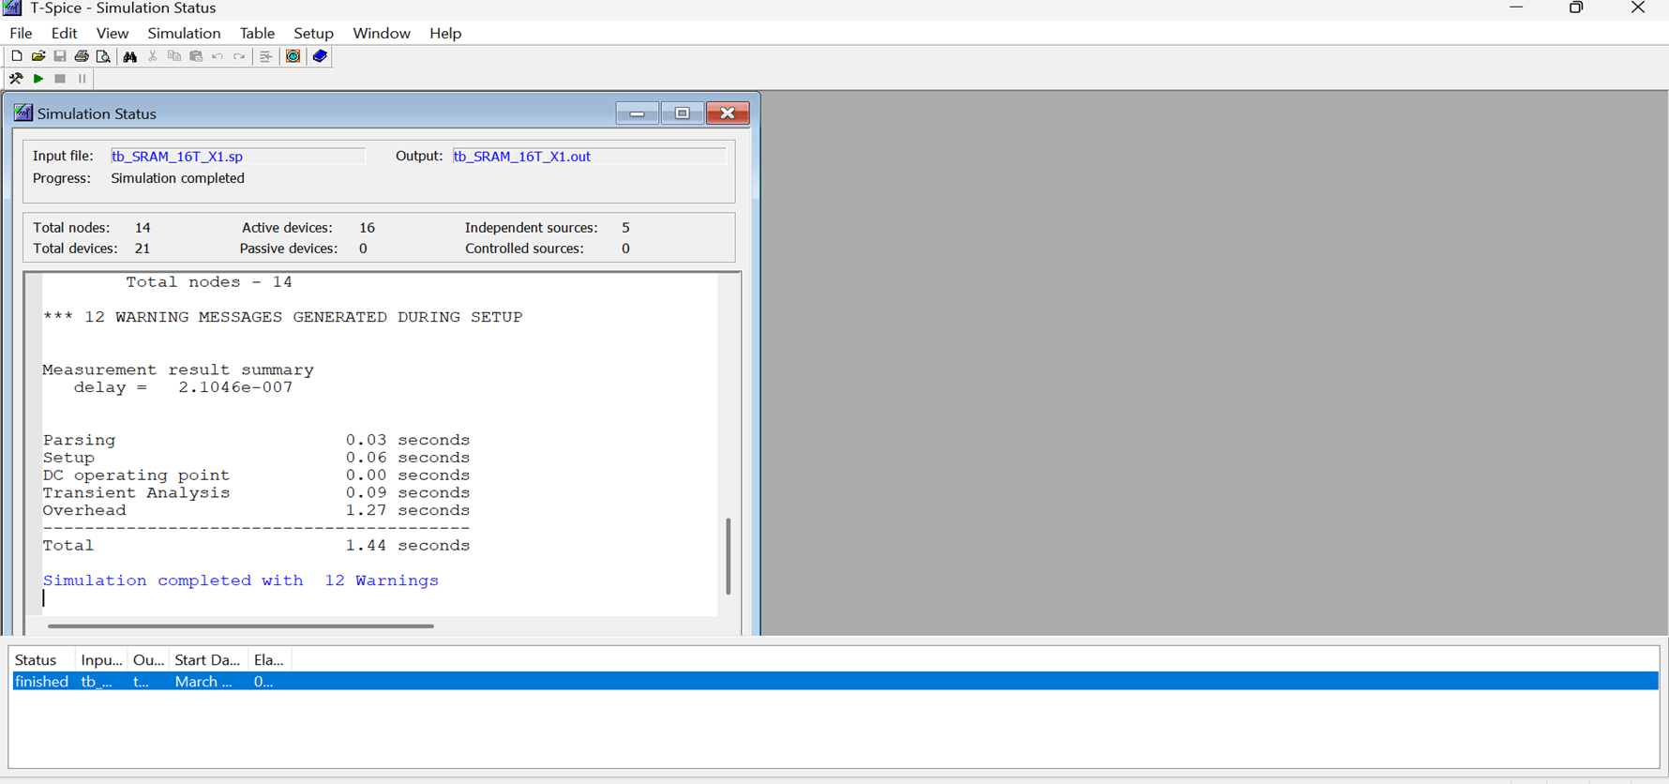
Output

Slide 12
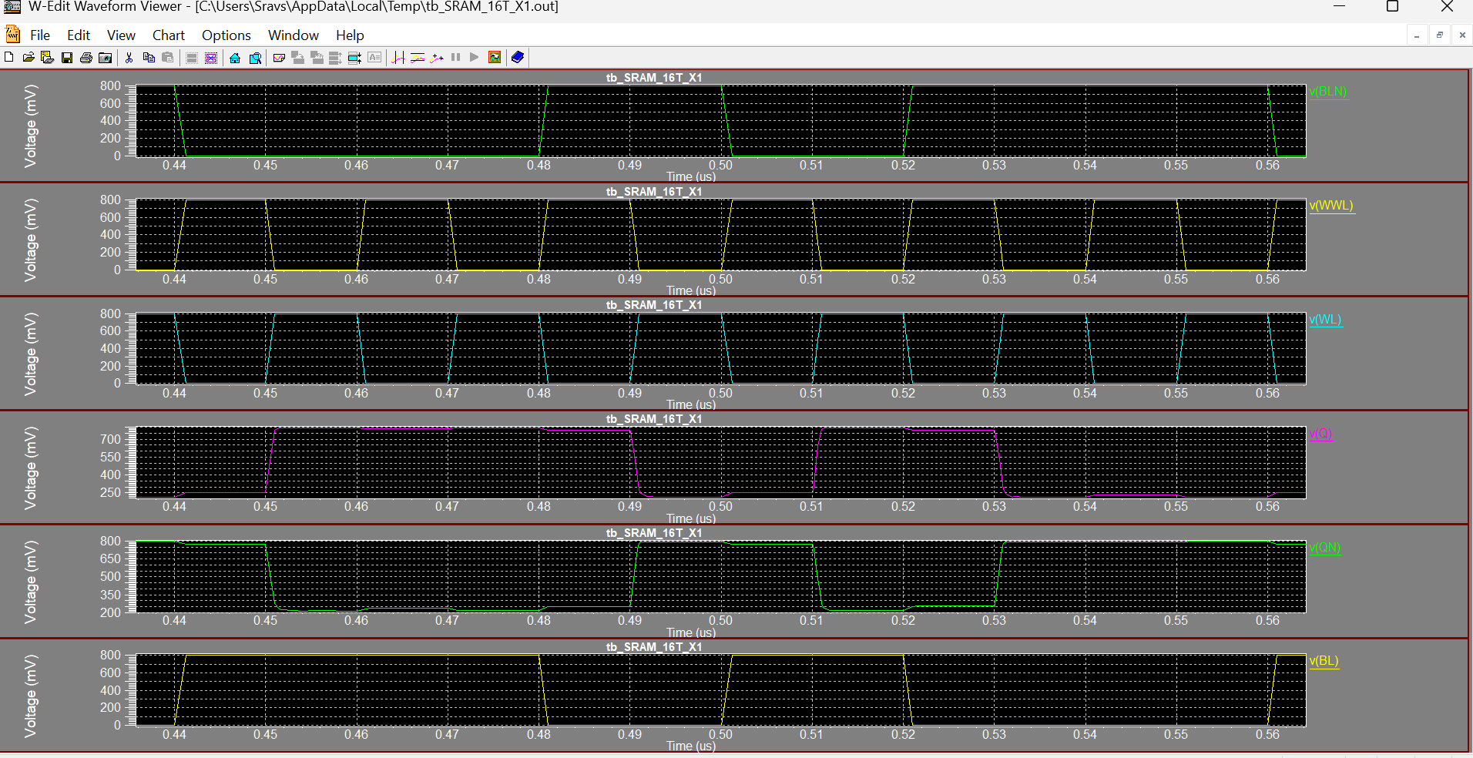
WaveForms

Slide 13
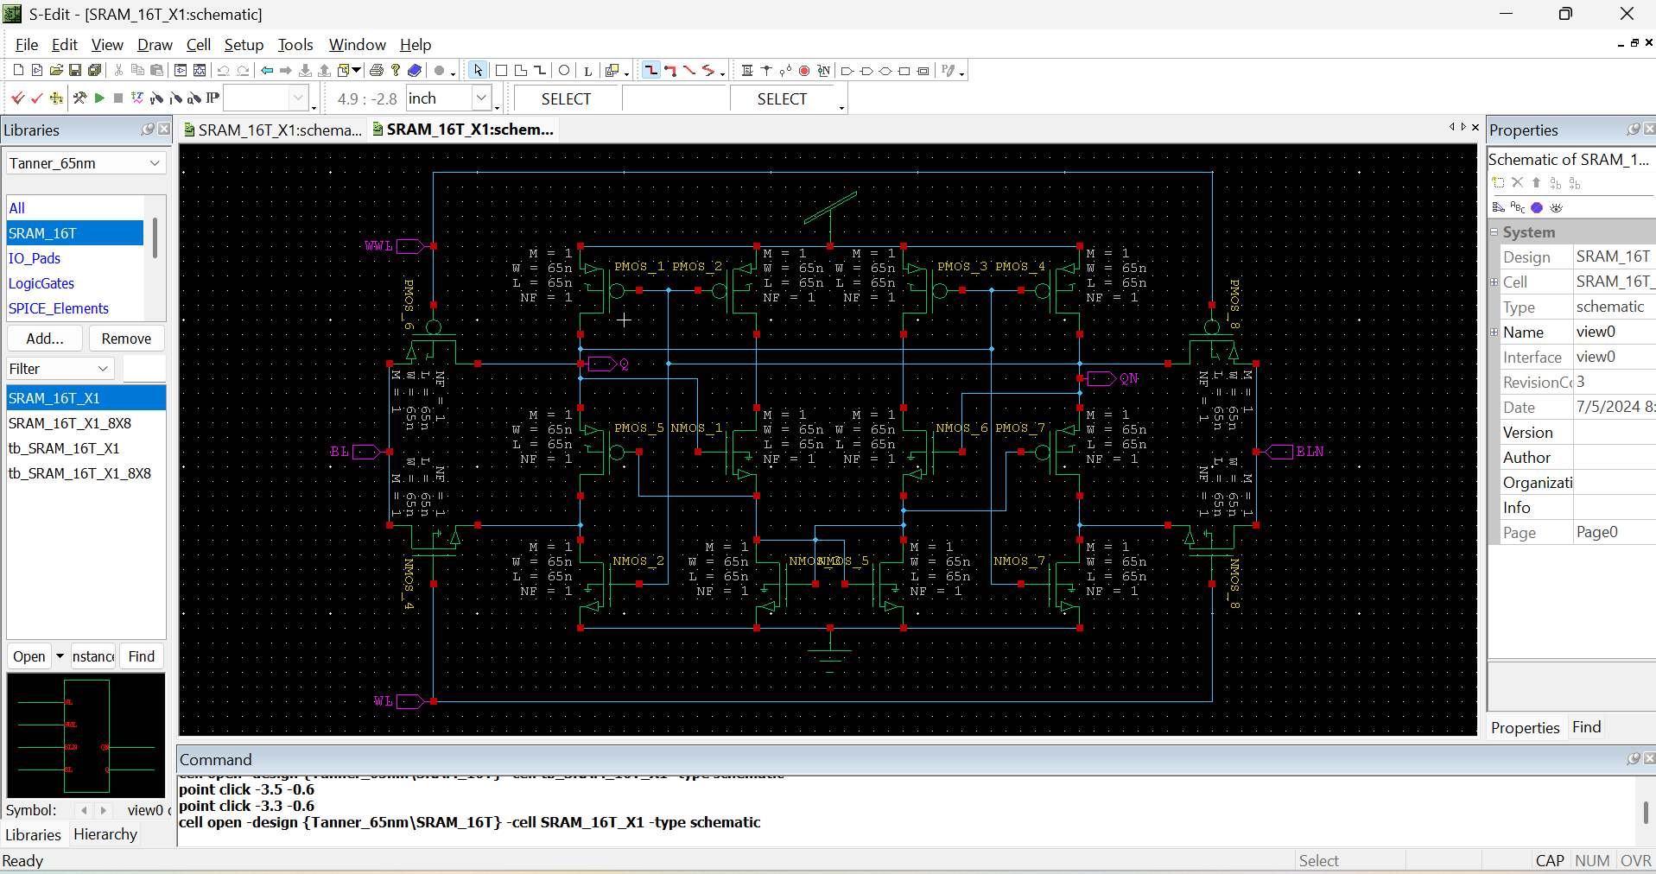
Using 65nm

Slide 14
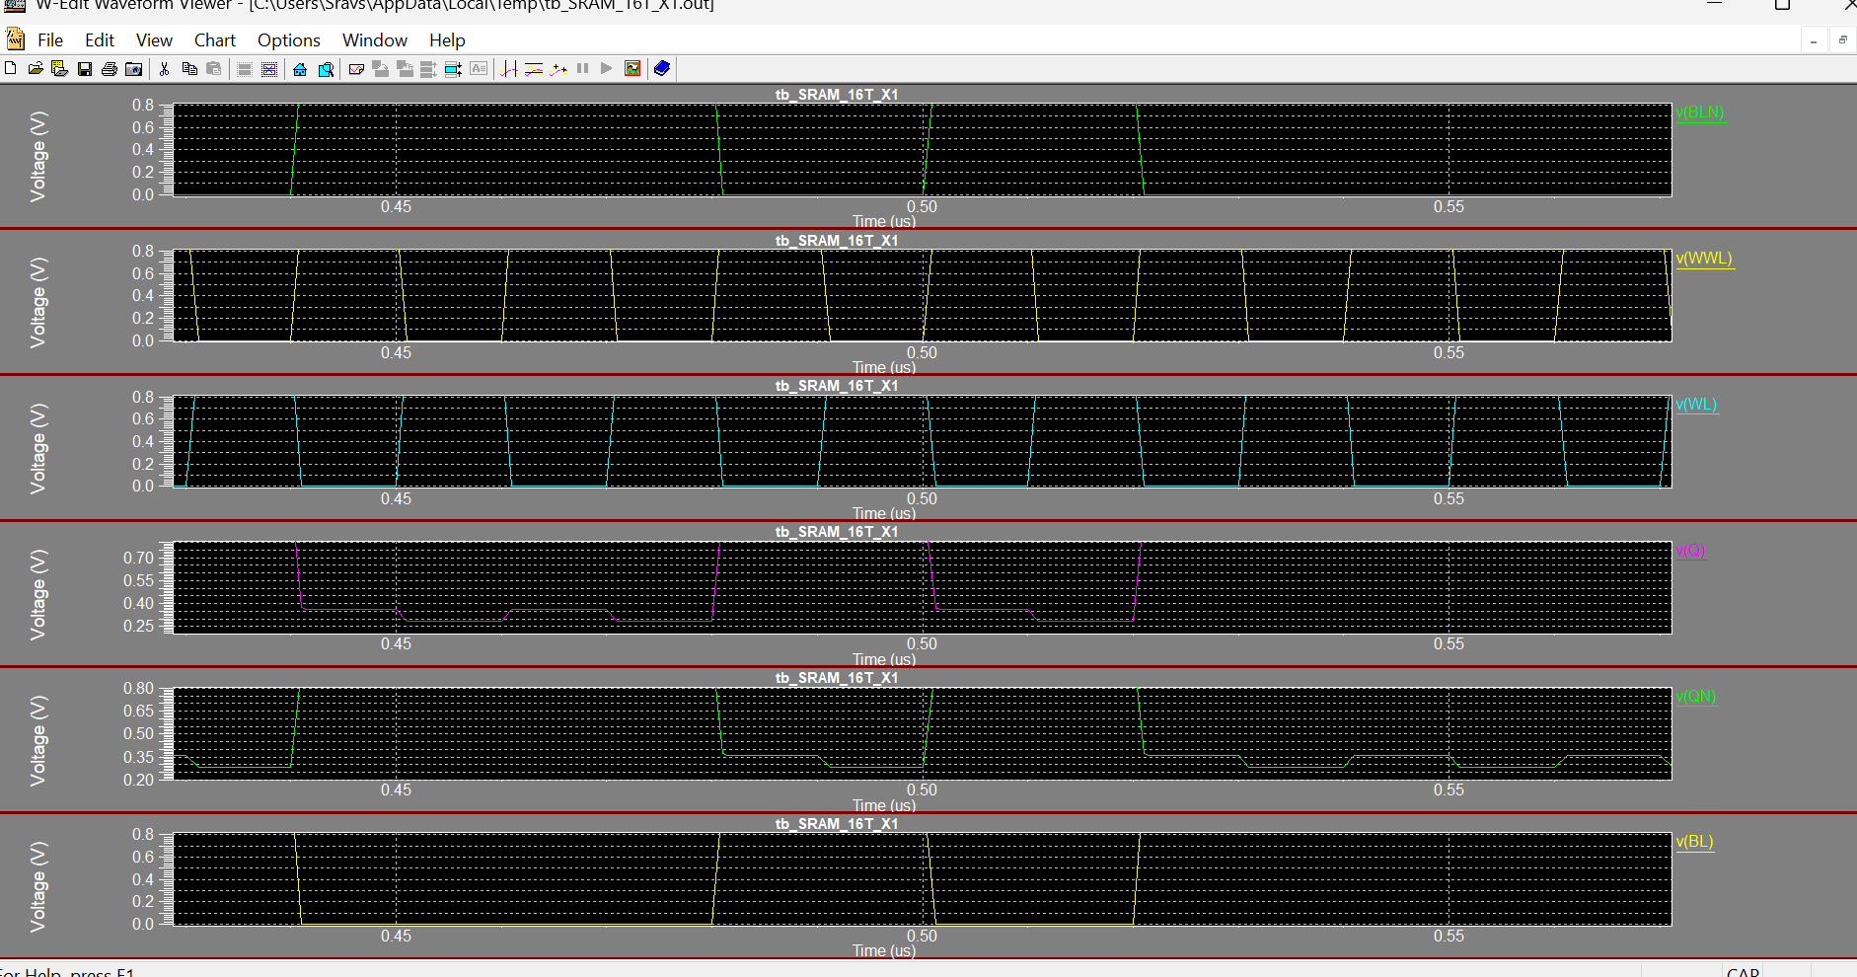
Using 65nm

Slide 15
Comparisions
 | 45nm |  | 65nm
 | Single Bit | 8x8 Array | Single Bit | 8x8 Array
Input Voltage(V) | 0.8 | 0.8 | 1.2 | 1.2
MOSFETs | 16 | 1024 | 16 | 1024
Area (um) | 0.720 | 46.080 | 1.040 | 66.560
Power (uW) | 0.767 | 49.097 | 138.68 | 8875.74
Delay (us) | 0.210 | 0.390 | 0.329 | 0.389

Slide 16
Conclusion
The paper presents low-power SRAM architectures such as AS10T, DS10T, and CNTFET-based designs to overcome power dissipation and leakage issues in conventional SRAM.
CNTFET-based SRAM proves to be a more efficient alternative to CMOS, offering reduced power consumption and enhanced stability for modern applications.
DS10T SRAM reduces write cycle power by 75%, making it highly suitable for IoT, wireless communication, and battery-operated devices.
The proposed designs improve read/write efficiency, noise margins, and power optimization, ensuring better performance in low-power and high-speed applications.
Future research can focus on scaling optimizations, hybrid transistor integration, and AI-driven power management to enhance next-generation SRAM efficiency.
Space and aerospace systems use low-power SRAM for radiation resistance, high-speed performance, and energy efficiency in satellites and deep-space missions.

Slide 17
References
[1] S. Pal and A. Islam, “Variation tolerant differential 8T SRAM cell for ultralow power applications,” IEEE Trans. Comput.-Aided Design Integr. Circuits Syst., vol. 35, no. 4, pp. 549–558, Apr. 2016, doi: 10.1109/TCAD.2015.2474408.
[2] S. M. Jahinuzzaman, D. J. Rennie, and M. Sachdev, “A soft error tolerant 10T SRAM bit-cell with differential read capability,” IEEE Trans. Nucl. Sci., vol. 56, no. 6, pp. 3768–3773, Dec. 2009, doi: 10.1109/TNS.2009.2032090.
[3] C. Peng et al., “Radiation-hardened 14T SRAM bitcell with speed and power optimized for space application,” IEEE Trans. Very Large Scale Integr. (VLSI) Syst., vol. 27, no. 2, pp. 407–415, Feb. 2019, doi: 10.1109/TVLSI.2018.2879341.
[4] S. Pal, S. Mohapatra, W.-H. Ki, and A. Islam, “Design of softerror-aware SRAM with multi-node upset recovery for aerospace applications,” IEEE Trans. Circuits Syst. I, Reg. Papers, vol. 68, no. 6, pp. 2470–2480, Jun. 2021, doi: 10.1109/TCSI.2021.3064870.
[5] S. Pal, D. D. Sri, W.-H. Ki, and A. Islam, “Soft-error resilient read decoupled SRAM with multi-node upset recovery for space applications,” IEEE Trans. Electron Devices, vol. 68, no. 5, pp. 2246–2254, May 2021, doi: 10.1109/TED.2021.3061642.

Slide 18
Thank You

